Slide 1

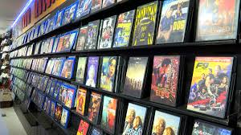
DVD Rental store analytics

Slide 2
Objective
Is to create a comprehensive Power BI dashboard using the Sakila DVD Rental Store Database, providing valuable insights into the rental store business.
The analysis will focus on customer behavior, film inventory management, staff performance, and store operations.
The goal is to enable data-driven decision-making and improve overall business performance.

Slide 3
Data dictionary
The dataset described is a comprehensive database that appears to represent a video rental store or movie rental service. It comprises multiple tables, each representing different entities and their relationships. Taking a closer look at the key components of the dataset:
Table Explanations
Actor Table
Address Table
Category Table
City Table
Country Table
Customer Table

Slide 4
Film Table
Film_text Table
Film_actor Table
Film_category Table.
Inventory Table
Language Table
Payment Table
Rental Table
Staff Table
Store Table

Slide 5
Problem statement with solution and insights
Problem Statement 1: Inventory Management
Problem: Managing DVD inventory efficiently to ensure that customers can access the movies they want without facing stockouts or overstocking.
Solution: Implement an inventory management system that tracks movie availability in real-time and uses data analytics to forecast demand. Regularly update inventory based on customer preferences and trends.
Insight: Data-driven inventory management reduces costs, improves customer satisfaction, and prevents revenue loss due to stockouts.

Slide 6
Problem Statement 2: Late Returns and Late Fees
Problem: Managing late returns, tracking late fees, and ensuring fair rental policies.
Solution: Implement clear rental terms and due dates. Use automated reminders via email or SMS to prompt customers to return DVDs on time. Consider offering grace periods to reduce late fees.
Insight: Effective communication and reminder systems can reduce late returns and improve customer satisfaction

Slide 7
Problem Statement 3: Customer Retention
Problem: Retaining customers in the face of competition from digital streaming services.
Solution: Develop a customer loyalty program with rewards, discounts, and personalized recommendations based on rental history and preferences. Enhance the customer experience with excellent service and a diverse movie selection.
Insight: Loyal customers are more likely to rent frequently and generate consistent revenue.

Slide 8
Problem Statement 4: Movie Selection
Problem: Curating a movie selection that caters to diverse customer tastes and preferences.
Solution: Analyze rental and customer data to identify popular genres, actors, and directors. Use this data to inform movie purchasing decisions. Rotate and update the movie selection regularly to keep it fresh.
Insight: Data-driven movie selection increases customer satisfaction and rental frequency.

Slide 9
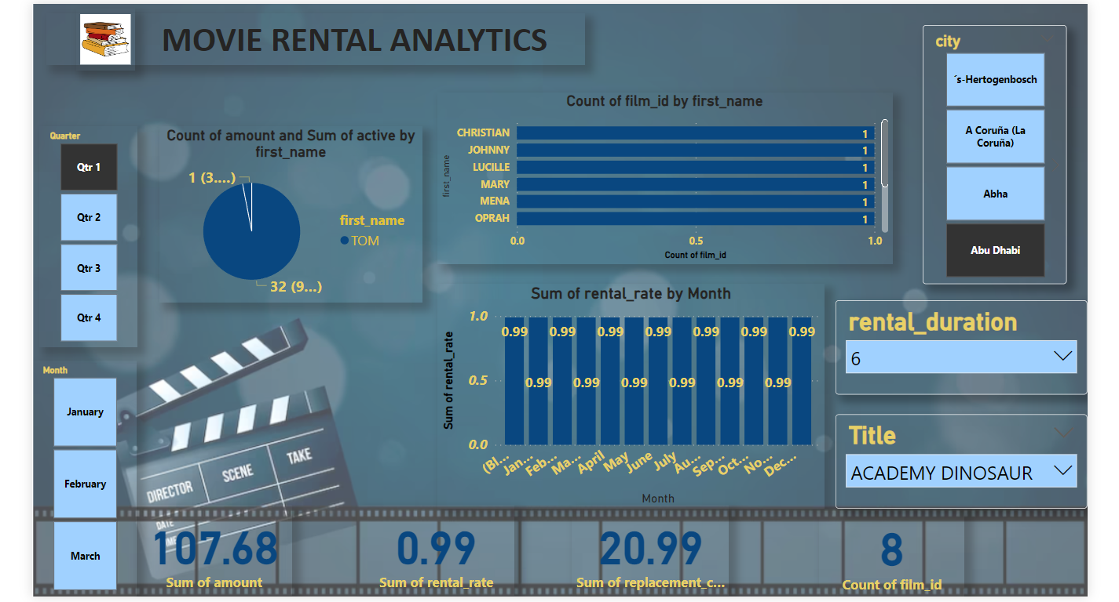
Layout of the dashboard

Slide 10
conclusion
Relies on efficient operations, data-driven strategies, and a customer-centric approach. By addressing the various challenges and opportunities inherent in this industry, businesses can not only survive but thrive in an ever-changing entertainment landscape.
Efficient inventory management ensures that customers have access to the movies they desire while minimizing costs and avoiding stockouts. Implementing data analytics and demand forecasting contributes to optimized inventory levels and better customer experiences.
Customer retention strategies, such as loyalty programs and personalized recommendations, foster long-term customer relationships and repeat business. Ensuring timely returns and handling late fees fairly through clear rental terms and automated reminders contributes to improved customer satisfaction.

